Slide 1
Welcome to year 5

Slide 2
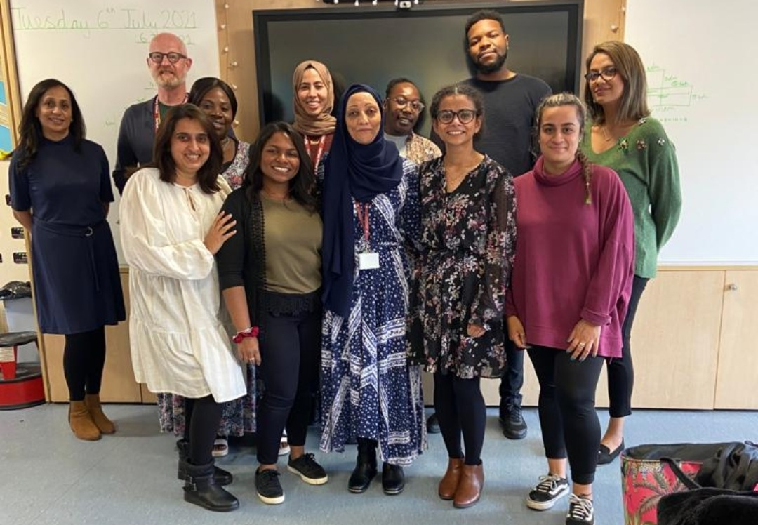
Meet the team
5R – Mr G
5S – Miss Kumaradevan (Year Leader)
5T – Miss Hirani
5U – Miss Al-Zeer
Learning Assistant: Mrs Shah, Mrs Naik, Miss Tiffany, Mrs Hussain, Mr Wright and Ms Angela
Student Teacher: Miss Shah
Year Group Phase Leader:
Mrs Van Amstel

Slide 3
Our Expectations
Joining upper school will be a change for your child, as they will be given more responsibility for their own learning. They will need be well equipped, organised and ready to learn at all times.
We will always ensure to challenge and develop the understanding the children have ensuring that they are ready for all stages of their educational journey, while giving them experiences and opportunities to enhance their learning further.

Slide 4
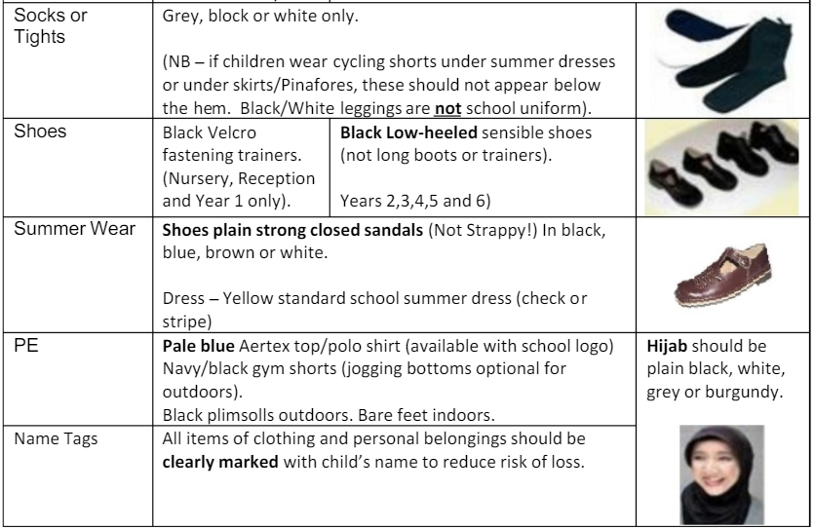
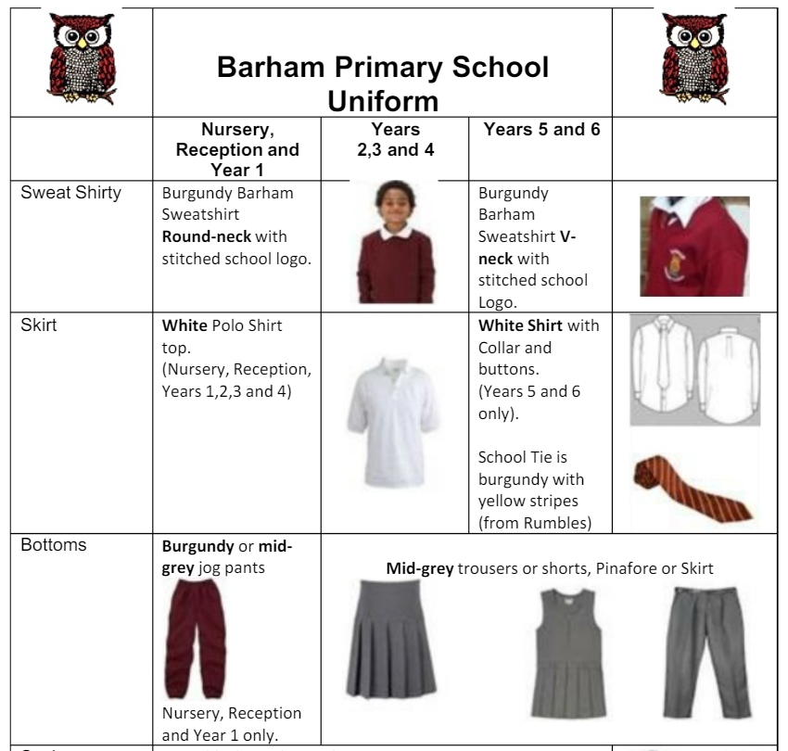
Uniform Expectations
In Year 5, it is essential that your child had a V-neck school jumper, a white shirt and wears the school tie, every day.

Slide 5
Behaviour Expectations
Especially being in the upper school, we expect pupils in Year 5 to be role models for all the pupils showing an excellent example of how they should behave.
Pupils should always ensure to behave at a high standard while acting in a mature and responsible way. They should ensure to follow the class rules and the school conduct.
It is key for all pupils to ensure that they respect everyone in the school.

Slide 6
Learning Expectations
Pupils will consistently be pushed to challenge and develop their understanding so they can grow as a learners.
It is crucial for pupils to ensure to ask for help when they are unsure of something.

Slide 7
English
Literacy – Throughout the year we will be teaching the pupils grammar and punctuation, both of which are crucial even when speaking and writing a variety of pieces.
Spelling – It is important that pupils grasp a solid understanding of spelling rules. Pupils will be set weekly spelling homework. They will also need to be secure both in the 3 and 4 spelling list and year 5 and 6 spelling lists.
Reading – It is key for children to read, daily, for at least 20 minutes. They should read a variety of texts to both challenge and extend their understanding.

Slide 8
Maths
It is essential for pupils to have a solid understanding of the following concepts, prior to coming to year 5:
Times tables up to 12 x 12
Practicing mental methods for + - x ÷
Telling the time in analogue and 24 hour formats.
Pupils will be set daily maths home learning which they must complete to the best of their ability to help consolidate the learning from the day.

Slide 9
Curriculum
When the pupils return in September we will be starting the exciting topic of the Anglo Saxons.
The pupils will also becoming scientists while they develop a secure understanding of Forces and Magnets as part of the Science topic.

Slide 10
Home learning
Home learning is a key part in the pupils developing a secure understanding of the concepts being taught so that they are able to continue to grow as learners.
Every piece of home learning must be completed to the best of the pupils’ ability and handed in on the due date. If not, the pupil will have breaktime detention.

Slide 11
Home learning
From September, this will be a timetable of the home learning your child will be receiving. Please ensure to make sure that your child has completed their homework, independently, to the best of their ability and that they bring it into school ready to go through when the homework is due:
Daily Maths and Writing homework – due the following day, to be completed in homework book.
Daily reading record– due the following day, to be completed in reading journals.
Weekly reading, writing and maths homework – due the following week, to be completed in homework book.
Weekly spelling – spellings will be tested the following week in class.

Slide 12
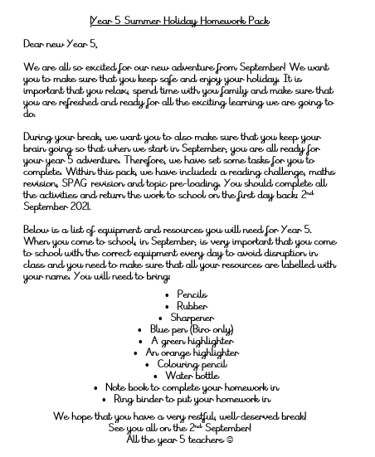
Home learning
Over the summer holidays, we have set your child homework which they will have to complete and bring in on the first day back to school: 2nd September 2021. We have provided your child with a paper copy and have put the homework on the school website for you to access.
You will be able to access the homework following this link:
https://www.barhamprimary.co.uk/attachments/download.asp?file=3253&type=pdf

Slide 13
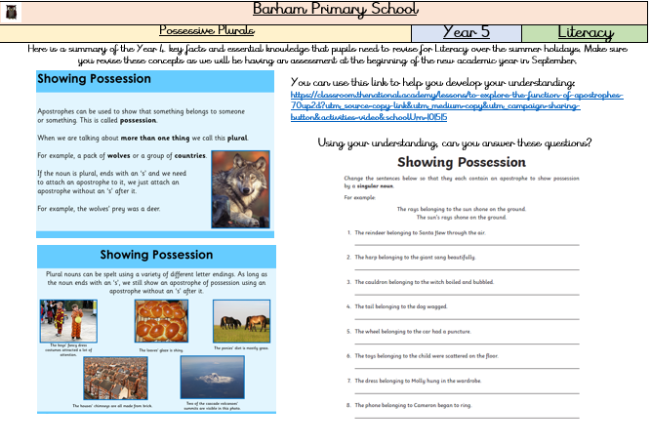
Home learning
For Literacy, we have given your child some revision based on possessive plurals. They can use the knowledge organiser, provided, and the link, provided, to help them revise the topic. We will be completing an assessment when the pupils return based on possessive plurals.

Slide 14
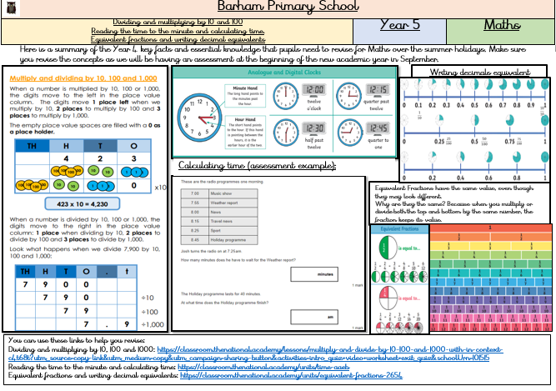
Home learning
For Maths, we have given your child some revision based on: dividing and multiplying by 10 and 100, reading the time to the minute and calculating time and equivalent fractions and writing decimal equivalents. They can use the knowledge organisers, provided, and the links, provided, to help them revise the topic. We will be completing an assessment when the pupils return based on the topics.

Slide 15
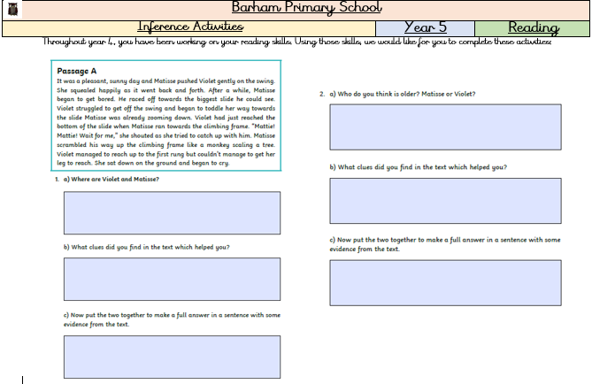
Home learning
For Reading, we have given your child two inference activities so that they can continue to work on the skills which they have been taught in year 4.

Slide 16
Home learning
We have also given your child an exciting reading challenge. Over the summer holidays, your child will need to read for 20 minutes (everyday.) When they return back in September, they will need to explain to their teachers what they have read. In order to make this exciting, we have provided your child with a 25 day reading challenge. Please take pictures of your child reading for the challenge which you can share with your child’s class teacher in September. We will be using these pictures for an exciting display!

Slide 17
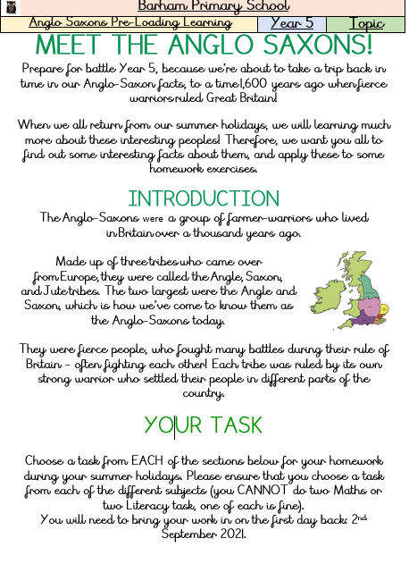
Home learning
When we return back in September, we are going to be learning about the Anglo Saxons. Therefore, as some pre-loading we have given your child a variety of Literacy, Reading, Maths and Science activities. Your child will need to choose one activity per topic and complete it. They will need to bring their work back in on the 1st day back, we will be giving prizes for the best topic homework in each class!

Slide 18
Online learning
Throughout the year, we will be using a variety of online learning platforms to enhance your child’s learning such as: SPAG.com, maths.co.uk and bugclub.
Your child will be given their logins in the first week, it is their responsibility to look keep the logins safe and to complete their work to the best of their ability.

Slide 19
ClassDojo
Parents are expected to login to ClassDojo and to check their messages daily. This platform is key for the parents to be able to communicate with their teachers and teacher to communicate with the parents.
Pupils will be given their ClassDojo logins during their first week back.

Slide 20
How can you help your child?
You can help your child grow as a learner through a variety of ways:
Speak to your child, daily, about what they have learnt.
Ensure your child has completed their daily home learning to the best of their ability.
Ensure your child reads, daily, for at least 20 minutes.
Provide your child with opportunities to use their mathematical understanding in every day situations.

Slide 21
What will your child need?
Your child will need to bring a pencil case to school, containing:
Pencils
Blue Pen
Rubber
Sharpener
Ruler
Glue Stick
Colour Pencils
Note book to complete their weekly and daily homework in
Folder to put their homework in
Please ensure that your child’s name is on all the equipment they bring in.
If there are any issues with providing your child with the stationary, please contact your child’s class teacher.

Slide 22
Swimming
Your child will be having swimming lessons this year.
It is a statutory requirement and it states in the national curriculum that primary aged children should be taught to:
swim competently, confidently and proficiently over a distance of at least 25 metres.
They will need the correct swimwear to be allowed into the pool
Swimsuit (one piece) OR tight fitting swimming shorts (modesty swimwear is available in shops)
Swimming hat
Towel
£1 for a locker
THEY ARE NOT ALLOWED TO WEAR ANY JEWLLERY
5S will be starting their swimming lessons from the 8th September 2021.
5U will be starting their swimming lessons from the 9th September 2021.
Pupils will be provided letters during the first week back with more information.

Slide 23
Thank you
If you have any questions, please do not hesitate to ask your child’s class teacher on the first day back. Please remember, the children line up in the lower key stage 2 playground.
We hope that you all enjoy your summer break! We look forward to welcoming both you and the pupils back on the 2nd September to begin your child’s year 5 adventure!

